Slide 1
Optimization of a Trip Around Europe
Alexander Russ, Gavin Morton, Nick Restifo
ISA 321

Slide 2
The Problem

Slide 3

The Problem
Planning a European trip is difficult, time consuming, and costly
We want to:
Minimize travel costs between 6 cities
Use the leftover money to do fun activities in each city
We have listed three potential activities to do in each city with a corresponding utility rating and cost

Slide 4

Relevance
There are a lot of students who plan trips to visit Europe after graduating college
We also personally want to do this trip ourselves
It is important to us to get the full European experience
Want to choose the activities wisely
Our budgets are not financially established immediately after graduating college
Maximizing our total utility out of our designated budget will allow us to get the best experience

Slide 5
Gathering Data
Expedia.com
------------------------------------------------------------
We chose a specific date and found ticket prices to and from each city on that date. Since ticket prices are so volatile, we have decided to use one single date in order to estimate the cost of the tickets across the span of our trip.
Moments.marriot.com
------------------------------------------------------------
We selected different tourist attractions in each city that we thought sounded fun or interesting. These were all found, along with the pricing for each, from moments.marriot.com. We then gave each activity our own utility rating.

Slide 6
The Mathematical Model
Parts 1 & 2

Slide 7
Part 1
Minimizing travel costs

Slide 8
Decision Variables
Our decision variable is a binary variable defined as X_{i,j}
X_{i,j} = 1 if we fly from city i to city j
0 if otherwise
Where:
“i” and “j” are defined by the cities: Chicago(C), Barcelona (B), Rome(R), Athens (A), Dublin (D), Paris (P), and London (L)
Note: “i” and “j” will never be equal to each other because we are not travelling within the city.

Slide 9


Objective Function
Our objective is to minimize the cost of travelling from city to city

Slide 10
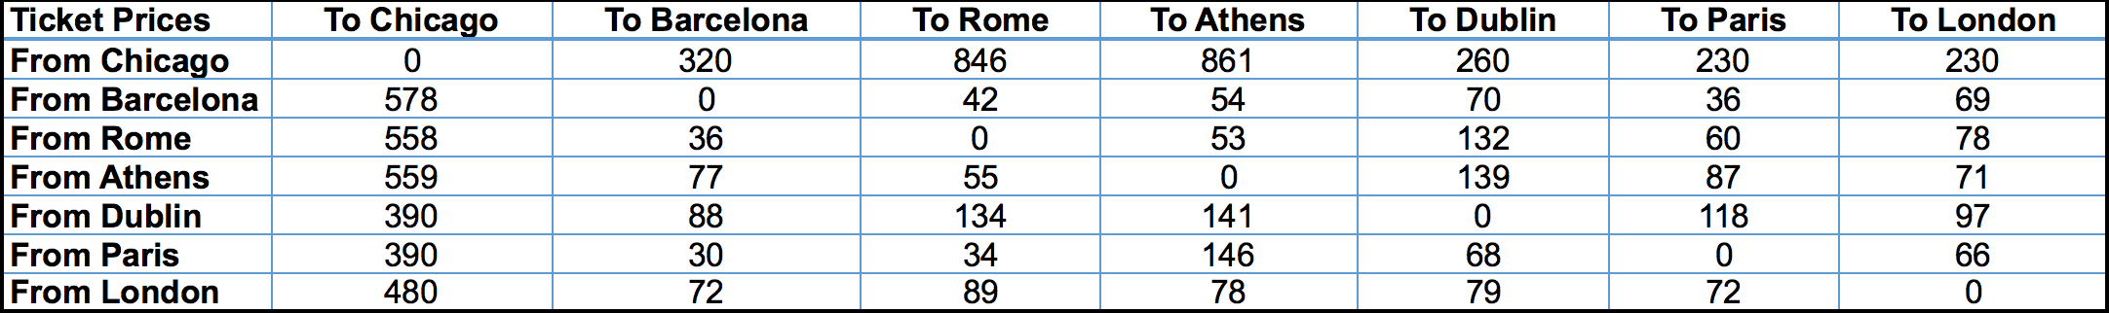
Price Matrix - P_{i,j}

Slide 11
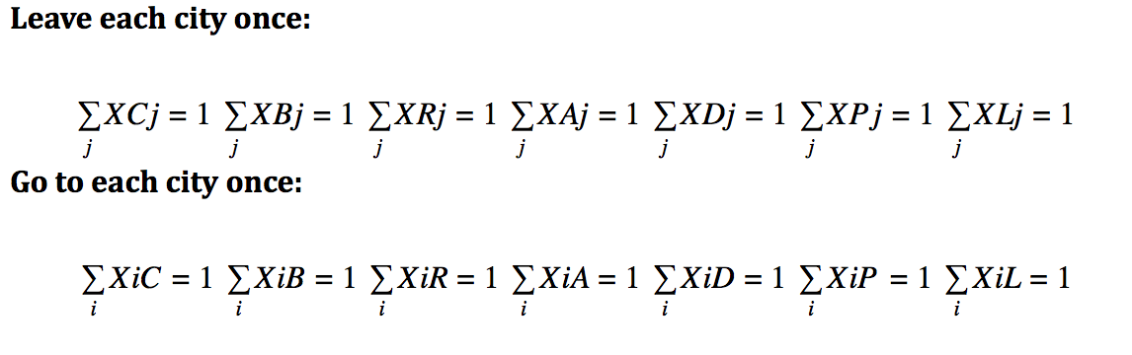
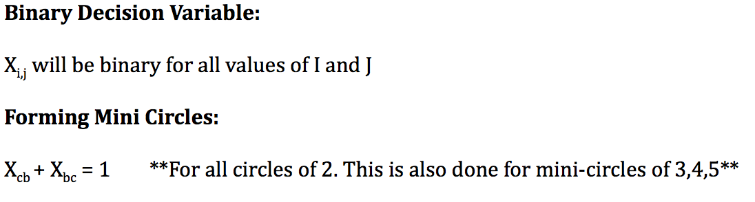
Constraints
Applied automatically through the use of the Traveling Salesman Package (TSP)

Slide 12
Part 2
Maximizing utility of fun activities

Slide 13
Decision Variables
Our decision variable is a binary variable defined as X_{i,n}
X_{i,n} = 1 if the activity is done in that city
0 if it is not
Where:
“i” represents the city, similar to problem 1
“n” represents the assigned number given to the activities
Note: Activities 1-3 will be in Barcelona, 4-6 will be in Rome, 7-9 will be in Athens, 10-12 will be Dublin, 13-15 will be in Paris, and 16-18 will in London

Slide 14


Objective Function
Our objective function is to maximize total utility of the activities based on our ratings.

Slide 15
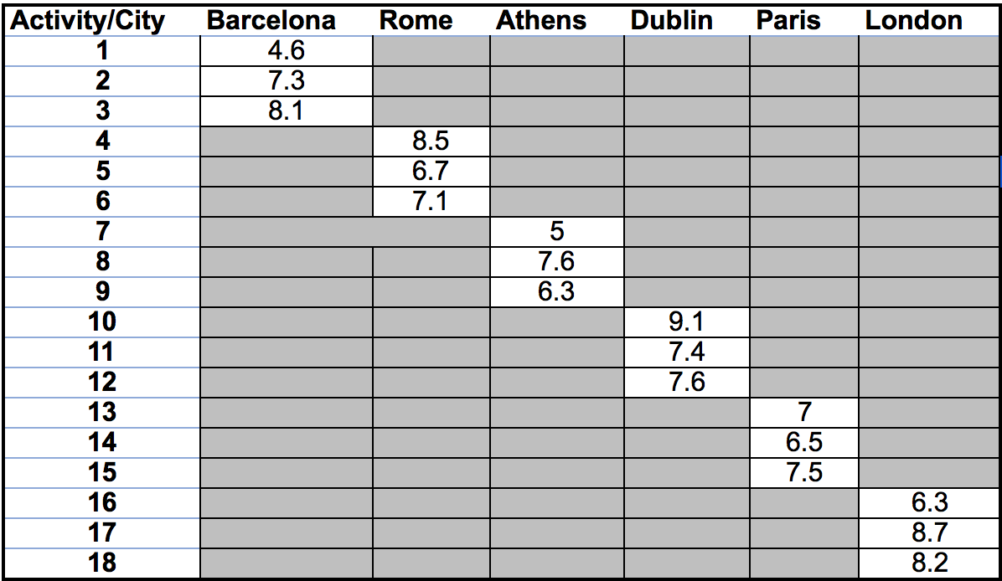
Utility Matrix - R_{i,n}

Slide 16
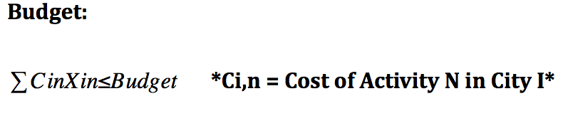
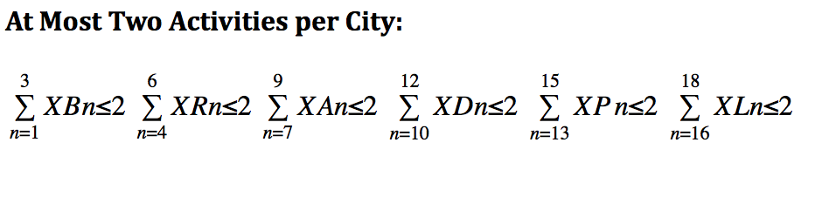
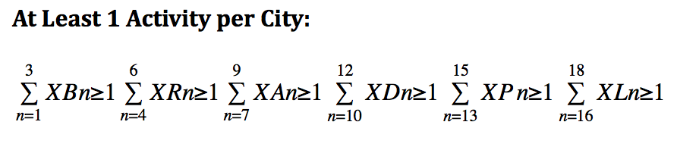
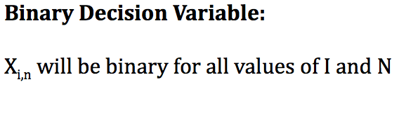
Constraints

Slide 17
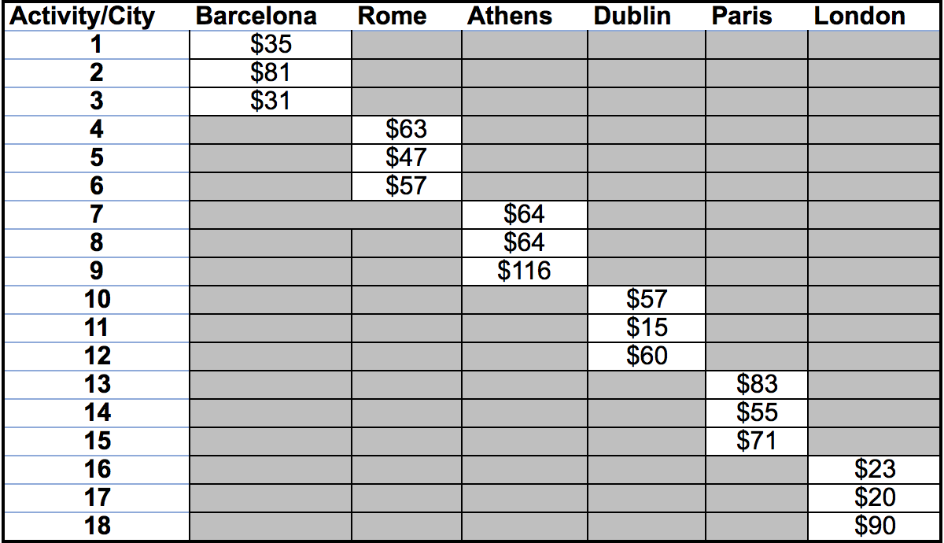
Cost Matrix - C_{i,n}

Slide 18
The Procedure

Slide 19
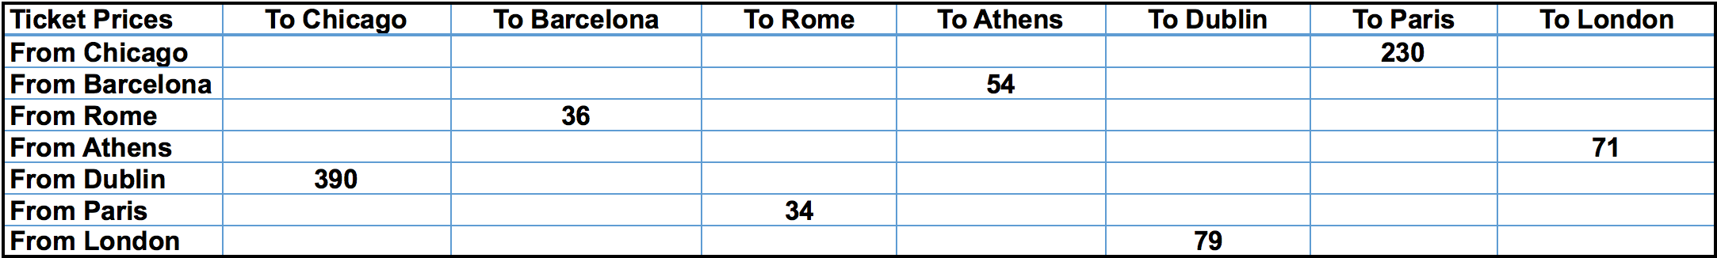
Optimized Ticket Prices

Slide 20
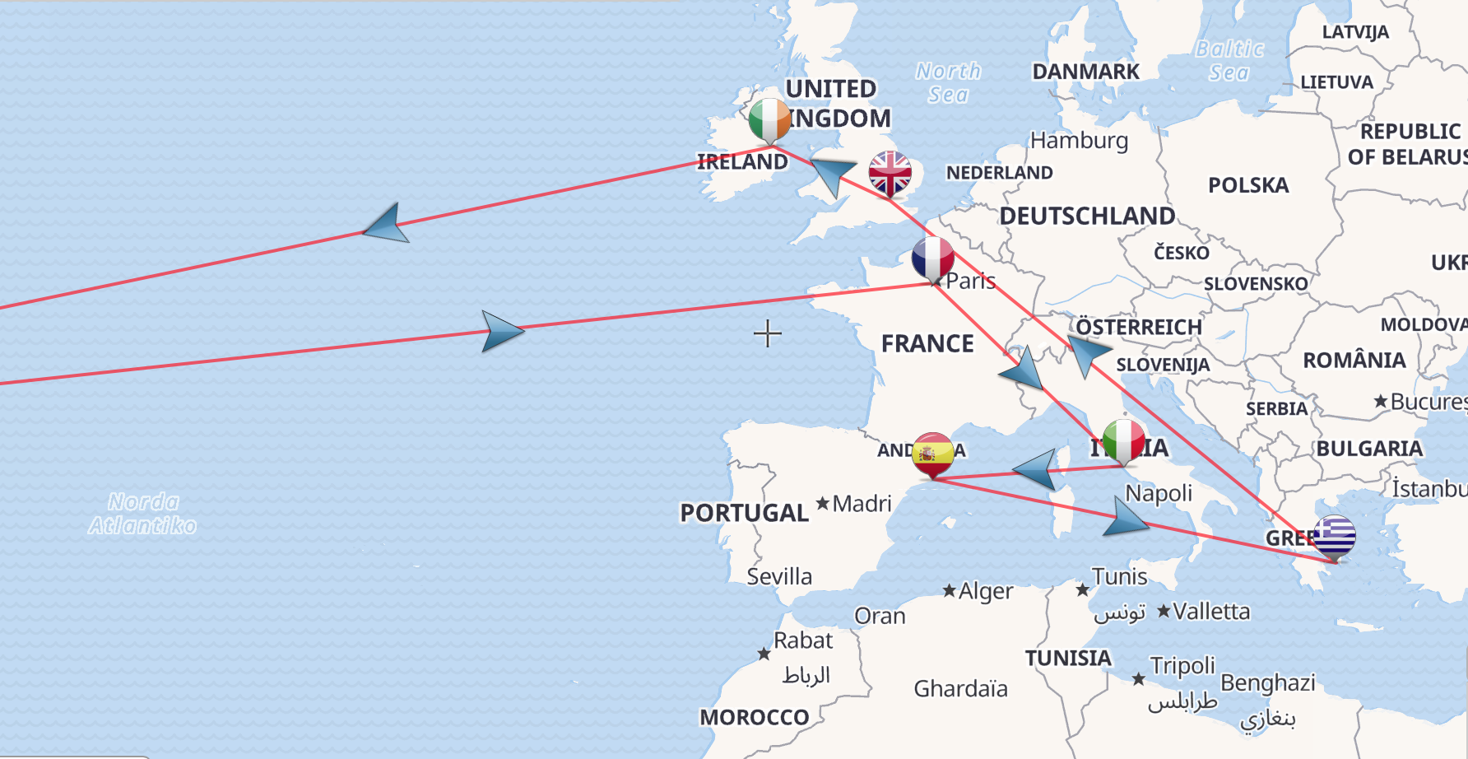
Problem 1 Solution:
Chicago to Paris: $230 Paris to Rome: $34
Rome to Barcelona: $36 Barcelona to Athens: $54
Athens to London: $71 London to Dublin: $79
Dublin to Chicago: $390
Minimization of Travel Cost through the use of the TSP package in R
Cost: $894

Slide 21
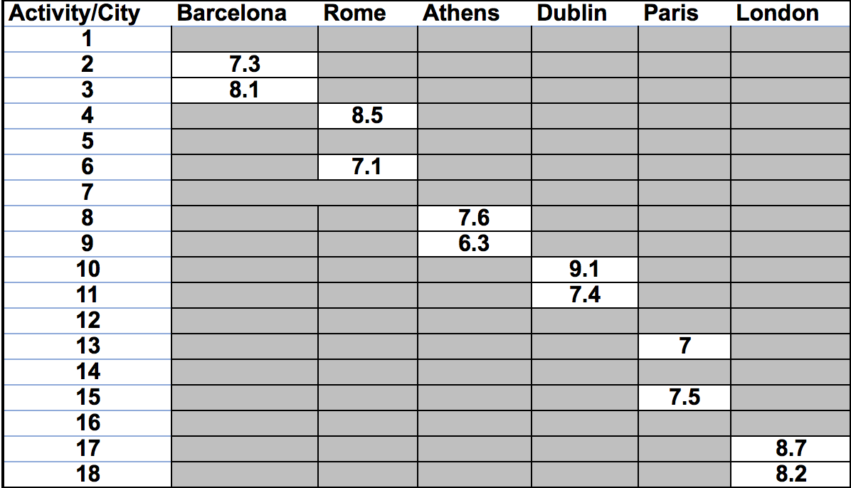
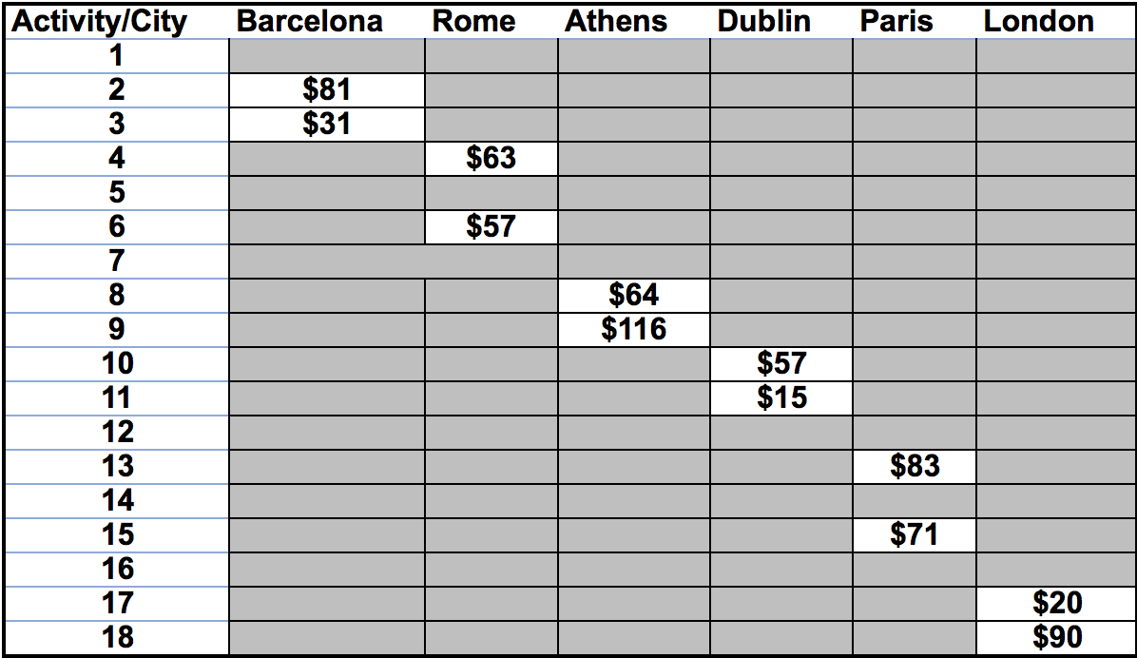
Optimization of Utility & Corresponding Prices
Optimized Utility
Corresponding Prices

Slide 22
Problem 2 Solution:
Barcelona:
Tapas evening walking tour of Barcelona - $81
Barcelona half-day bike tour - $31
Rome:
3 hr Ravioli and Meatball cooking class - $6
Ancient Rome/Colosseum half-day walking tour - $57
Athens:
Athens half-day sightseeing tour - $64
Hydra, Poros, and Egina Day cruise - $116
Dublin:
Whiskey Tasting tour - $57
Malahide castle and gardens admission ticket - $15
Paris:
Louvre Express tour - $83
Early evening dinner cruise - $71
London:
Pub crawl of central london - $20
3.5 hour small group food-tasting tour - $90
Maximization of utility of fun activities in R with a remaining budget of $751
Cost: $748

Slide 23
Testing the Model

Slide 24
Activity Budget Trade off
Original Budget: $2,500.00
Minimized Travel Cost: ($894.00)
Housing costs of Airbnb ($845.00)
Remaining Budget: $751.00
With a starting budget of $2,500, you are left with $751.00 in spending money for activities
If a person were to do all three activities in each city, it would cost a total of $1,032.00
Therefore, our budget constraint will cause people to think wisely about which activities to pursue.

Slide 25
Model Application & Insights

Slide 26
Insights
Problem 1
Not much changes when we minimize costs
Costs for each ticket will be fixed on a fixed day
If we all buy tickets for every flight on the same day, the prices will not change
Our model becomes helpful when the trip exceeds 6 cities
Our model can also scrape ticket prices from online which is very beneficial
Therefore, there is no need for a travel agent
Problem 2
Multiple changes can be made to problem 2
Each personal budget has the opportunity to change
We can also make a constraint that forces people to do a certain activity or not having the ability to do something because it closes

Slide 27
Model Efficiency
Most efficient way to plan a large vacation such as this
The model is worth the hassle
The model elevates both our ratings and prices for different activities
Very cumbersome to do by yourself
Lose patience
Travel agents become expense
Model includes personal inputs such as the happiness levels to ensure trip enjoyment while staying within your budget

Slide 28
Future Model Implementations

Slide 29
Model Limitations
We did not to a full search for plane tickets, we found a reasonable price and stuck with it
Did not search for possible deals or promotions
Limited our model to one way flights to all cities
There are other methods to travel around Europe
We did not take into account location of Airbnb
Our model is limited to the number of activities a person can do per city
People should have the freedom to do more than 3 activities and fewer than 2 activities in a given city if they want

Slide 30
Questions?

